Slide 1

E-Commerce Marketing
Domain : E-Commerce
SRI RAM K

Slide 2
Problem Statement
Objective: Optimize the marketing budget to enhance revenue response by analyzing the sales trends across different product sub-categories.
Focus Areas:
Camera Accessories
Home Audio
Gaming Accessories
Key Goal: Should the firm streamline or reallocate the marketing budget strategically?

Slide 3
Tools Used
Programming Languages and Libraries for data processing:
Python
Pandas
Numpy
Seaborn
Matplotlib
Machine Learning/Deep Learning Frameworks:
Scikit-learn
TensorFlow/Keras
Storage and Collaboration:
GitHub for version control
Other Tools: PowerPoint for presentation

Slide 4
Data-Driven Modeling Strategies
Data Preprocessing: Cleaning, handling missing values, feature engineering (pay date flag, holiday flag, climate data, AOV).
Exploratory Data Analysis (EDA): Explored sales trends by product categories and time periods (histograms, scatter plots, correlation analysis).
Model Selection & Building : Linear Regression, XGBRegressor, RandomForestRegressor, SVM, Deep Learning models (based on EDA insights). Identified feature importance and key drivers of sales for each sub-category
Model Training and Evaluation: Using train-test split and relevant metrics (MAE, MSE, R-squared).

Slide 5
Feature Engineering
Aggregated GMV and units sold per week for each sub-category as per business requirement
Pay Date Flag: Add a flag to indicate if the week contains the 1st or 15th of the month (typically pay dates).
Holiday Indicator: Use a holiday flag to mark significant Canadian holidays (e.g., Christmas, New Year, Canada Day).
We’ll mark holidays based on a few common Canadian holidays during the dataset period:
Christmas (December 25th)
New Year (January 1st)
Canada Day (July 1st)
Climate Data Integration: Add temperature and precipitation data for Ontario by week (we could simulate this if you don't have climate data readily available).
KPIs:
Average_Order_Value(AOV) = Total GMV / Total Units

Slide 6
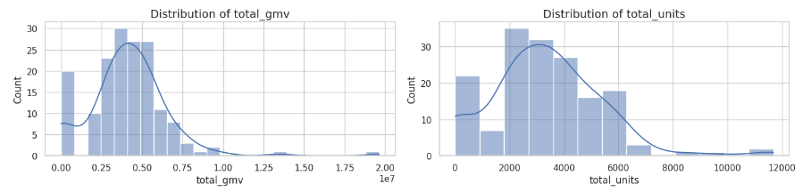
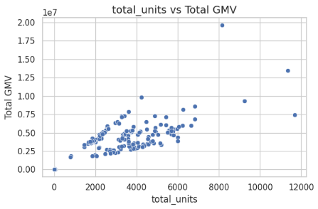
EDA Insights
Distribution of GMV and Units Sold: Skewed to the right, indicating potential outliers.
Total Units vs. Total GMV:
A clear positive relationship exists. As the number of units sold increases, total GMV also increases, which is expected.

Slide 7
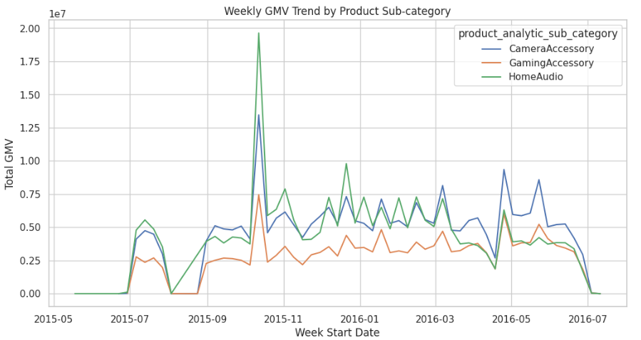
Seasonal Trends: Variations in sales patterns across different time periods.

Slide 8
Weekly GMV Trend by Product Sub-category:
The time series plot reveals seasonal trends in sales: The plot shows weekly GMV (Gross Merchandise Value) trends for three product sub-categories: Camera Accessories, Gaming Accessories, and Home Audio, from May 2015 to July 2016.
Unexpected Trends: There is a notable spike around October 2015, particularly for House Audio and Camera Accessories, suggesting a major event or sale (e.g., promotional campaigns, product launches, or seasonal demand).
After the spike, GMV stabilizes but continues to show regular fluctuations over time.
Temperature had no significant impact on sales, indicating that demand for these electronic products is relatively stable year-round.
June 2016 downtrend: All three categories show a decline toward the end of the period, which could align with seasonal trends or the company's change in marketing focus. We dont have data for that.

Slide 9
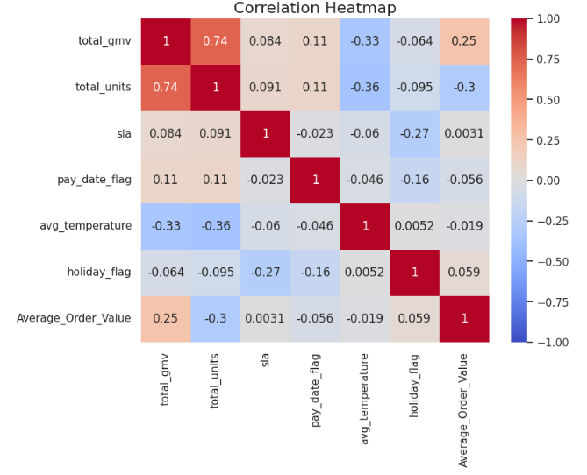
Correlation Heatmap
There is a strong positive correlation between GMV and units sold, confirming that these two metrics the directly impact of sales volume on revenue.
Weak correlations with delivery time indicate that improving SLA alone may not drive significant revenue growth.

Slide 10
Observations (EDA)
Relationship between Units Sold and GMV (Gross Merchandise Value):
There is a clear positive correlation between units sold and total GMV. As expected, the more units sold, the higher the revenue.
Camera Accessories typically show a higher GMV for fewer units, implying premium pricing, whereas Gaming Accessories generate GMV from higher volumes.
Impact of Service Level Agreement (SLA) on GMV:
No strong trend was observed between SLA (delivery days) and GMV, suggesting that faster delivery might not directly influence revenue for these products.
Outliers/Peak Sales:
Some weeks showed unusually high GMV and units sold, indicating potential promotional campaigns or holiday-driven purchases.

Slide 11
Model Results and Performance
Best Models for Each Sub-category:
Camera Accessories:
Model: Linear Regression
R²: 0.93 | RMSE: 0.0373 | MAE: 0.0013
Home Audio:
Model: Linear Regression
R²: 0.93 | RMSE: 0.0375 | MAE: 0.032
Gaming Accessories:
Model: Linear Regression
R²: 0.94 | RMSE: 0.0362 | MAE: 0.024
I have also develop RandomForestRegressor, Support Vector Machine and XGBRegressor models but the deviation in train, test score is higher. Since Linear Regression has been performed in all Sub-Category.

Slide 12
Feature Importance/Key Variables
Top Feature:
Total units and Average Order Value are consistently important features, indicating their strong predictive power.
Other Important Features:
The importance of product subcategories Gaming Accessory and Home Audio have some importance, but they are much lower than total_units_sqrt. These represent the sub-categories of products and seem to have some impact.
Less Important Features:
Camera Accessory has relatively low importance than other sub-categories.
sla (possibly service-level agreement or delivery time), and avg_temperature have minimal importance.
Features like pay_date_flag and holiday_flag seem to have no impact on the model, as indicated by the near-zero permutation importance.

Slide 13
Model Results and Performance(DL)
Input Layer: Accepts features based on the input shape of the data.
Hidden Layers: Two dense layers with 128 and 64 neurons, respectively. Each layer uses ReLU activation function to introduce non-linearity. Dropout layers with a rate of 0.2 are added after each hidden layer to prevent overfitting.
Output Layer: A single neuron with a linear activation function to predict the target variable (total_gmv).
Optimizer: Adam with a learning rate of 0.001.
Loss Function: Mean Squared Error (MSE).
Metrics: Mean Absolute Error (MAE) and MSE.
Sub-Category MAE MSE RMSE
Camera Accessory 0.122 0.025 0.083
Home Audio 0.122 0.026 0.122
Gaming Accessory 0.118 0.023 0.071

Slide 14
Feature Importance (Deep Learning Model)
Similar to machine learning model Total units emerges as the most important feature, highlighting its strong predictive power for sales.
Gaming Accessory and Average Order Value are also important, suggesting that product sub-category and order value influence sales.
Other features have limited impact, including product Camera Accessory and Home Audio.
The importance of temperature, pay date flag, sla, and holiday flag fluctuates, implying context-dependent or interaction effects.
Observations:
Linear Regression significantly outperformed the deep learning model based on the provided metrics for all sub-categories.
This suggests that, for this specific dataset and task, a simpler linear relationship might be sufficient for capturing the underlying patterns in the data.
The deep learning model might have suffered from overfitting or might require further tuning to achieve comparable performance to Linear Regression.

Slide 15
Conclusion and Recommendations
Recommendation to Re-allocate Marketing Budget:
Focus more on Camera Accessories and Home Audio during September, as they show peak sales during that period.
Optimize discounts for Gaming Accessories to capitalize on their price-sensitive customers.
Review and refine ad campaigns to ensure investments yield expected returns.
Product Bundling Strategy:
Bundle related products (e.g., Camera Accessories + Memory Cards) to increase average order value (AOV). This approach can also improve the GMV per transaction.
Maintain Consistent Delivery SLAs:
Although delivery speed doesn’t significantly impact sales, it’s still valuable for customer satisfaction—focus on maintaining SLA consistency.
Consider offering free expedited delivery for high-value orders to increase customer satisfaction and loyalty.

Slide 16


